Slide 1
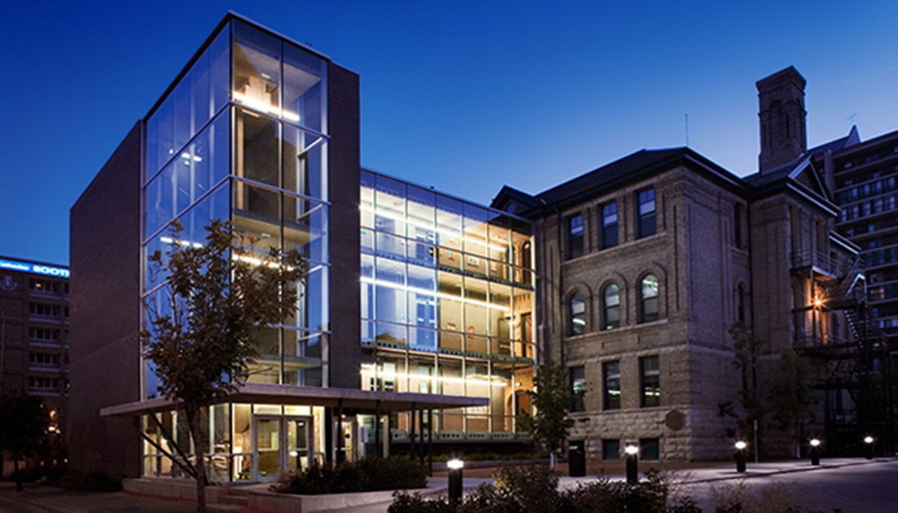
Welcome to WAEC!
10E Intro EAL

Slide 2

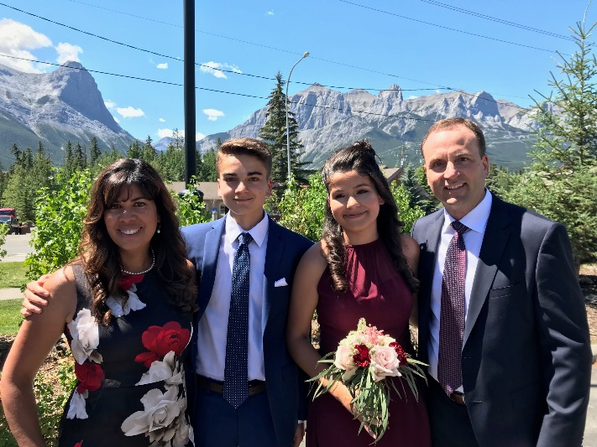

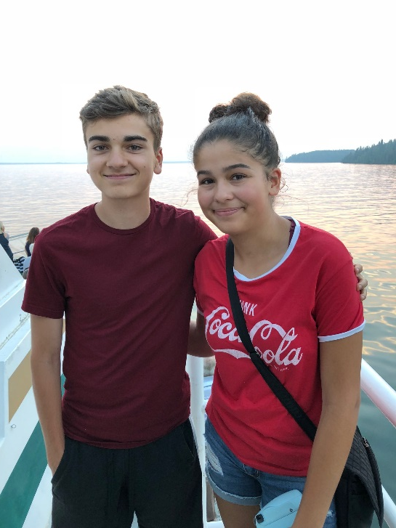
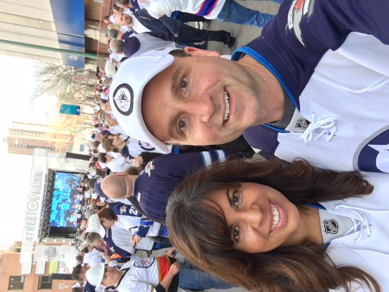


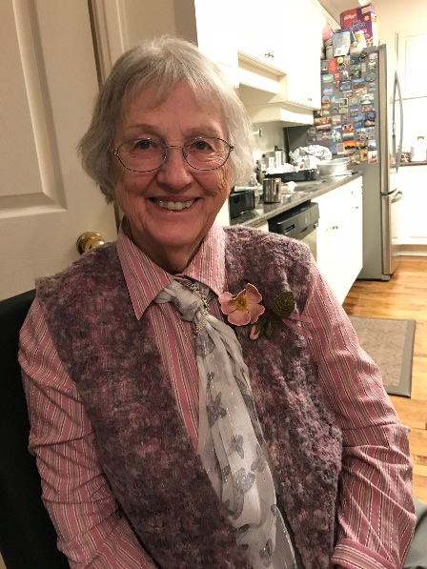


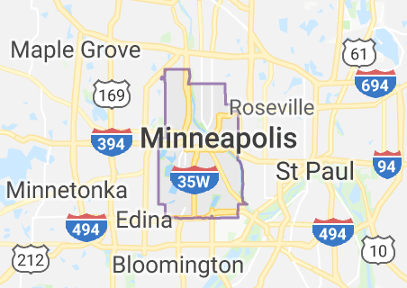


Let me introduce myself…
Melanie Elizabeth Fenton
29
51

Slide 3

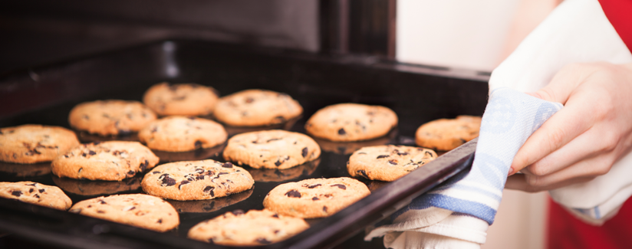
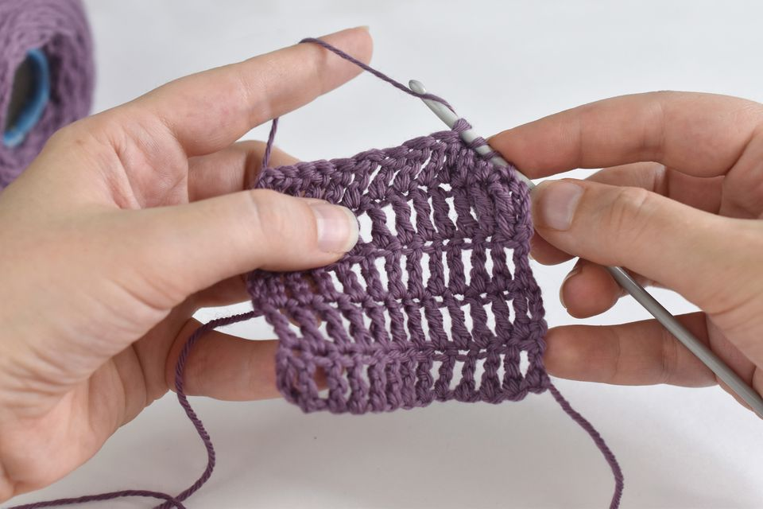

Let me introduce myself…
Patricia Bispo
30
3

Slide 4
Ways to Reach Me:
My Office/Resource: Room 208 or Library (2:10 – 3:25 pm)
Email: mfenton@wsd1.org

Slide 5
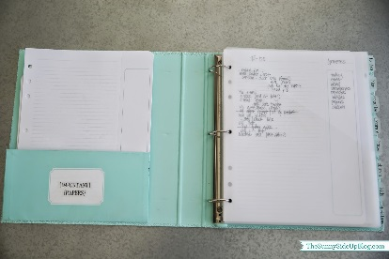


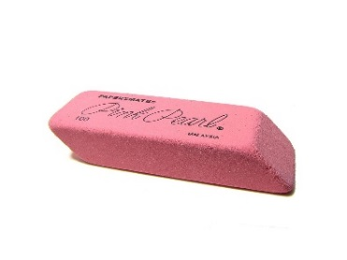


Are you ready to write?
Do you have a binder?
Do you have a pencil?
Do you have an eraser?
Do you have a pen?
Do you have a highlighter?

Slide 6
Entering the Room
Please enter quietly.
Have a seat.
Take out your materials.
Review the agenda on board.
Begin morning assignment.

Slide 7
Important Upcoming Dates:
Feb. 17 – In-service (Louis Riel Day) –No School
Feb. 24 – In-service –No School
March 13 – In-service – No School
March 28 – April 5 – Spring Break – No School

Slide 8
Important Dates
SEMESTER 1 – Sept. 3, 2019 – Jan. 31, 2020
Term 1 – Sept. 6 – Nov. 8, 2019
Term 2 – Nov. 12 – Jan. 31, 2020
SEMESTER 2 – Feb. 3, 2020 – June 30, 2020
Term 3 – Feb. 3 – April 17, 2020
Term 4 – April 20 – June 19, 2020

Slide 9
Location of Rooms
Room 202 – My classroom
Room 208 – My office
Washrooms – 3rd floor & in basement
Resource Room – Library
Student Lounge – Main floor
Library – 3rd Floor
Office – Main floor
Guidance Counsellors – Main floor (office)

Slide 10


WAEC is a scent-free & nut-free environment

Slide 11

No smoking on school grounds

Slide 12

No drugs or alcohol at school

Slide 13

Lockers are available first come, first served -See office

Slide 14


Student parking, bus pass Peggo Cards –see office

Slide 15

WiFi available, username and password for computers
WiFi password: 3tern@L$ (case sensitive)

Slide 16

Attend school regularly!

Slide 17

Use Recycle Bins (no coffee cups accepted in beverage recycling)

Slide 18
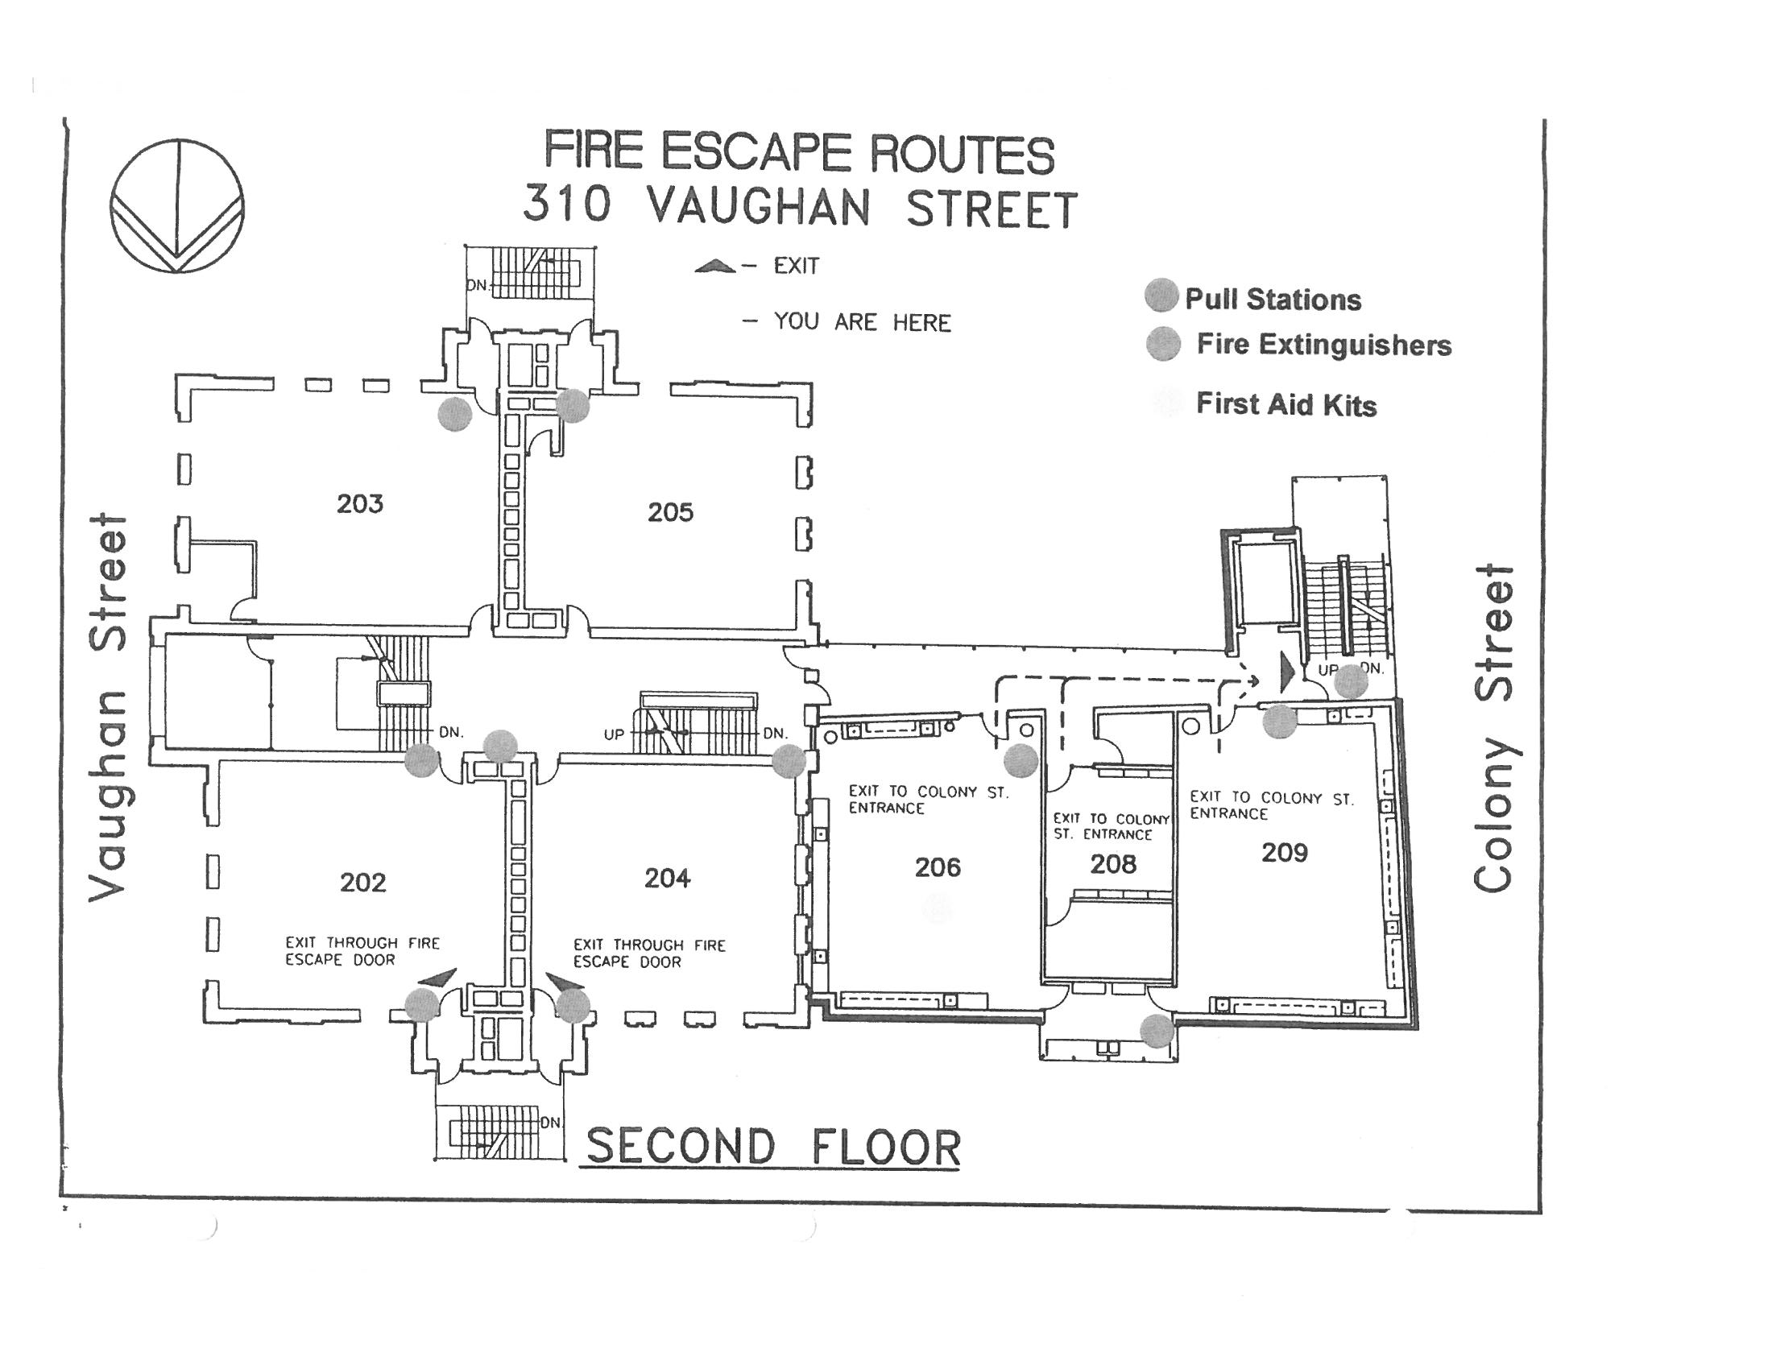

Fire drills, lockdowns, evacuation drills

Slide 19

Driver’s Education course available (see Guidance)

Slide 20
Check whiteboard, monitor outside of office & school website for messages

Slide 21
BLOG
-Use the class blog when you’ve been absent so that you can catch up on the work we’ve done in class.
-There are also many useful links to websites, YouTube clips, readings, etc. on the blog that will help you work on your English skills.
How to get to the BLOG: ealfenton.home.blog

Slide 22
Special Language Exams:
Tues., Nov. 19,
Wed., Nov. 20, 6:00 p.m.
Thurs., Nov. 21
Deadline for applications: Fri., Oct. 4

Slide 23
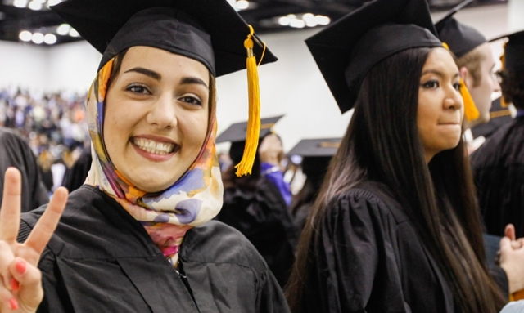
Graduation Ceremony at the end of June

Slide 24

Have a GREAT SEMESTER!!!

